Slide 1
Why Europe?
Introduction
1.For 5000 years, our view looking at EARTH has been unchanging. However, if we look at Earth with electrical energy different regions produce, we will find a puzzling situation.
2.This situation is that most of the energy production is occurring where relatively few people live.
3.In other words, the disparity between the rich and the poor in our globe is very huge.

Slide 2
Explanations and negations of the gap between the rich and the poor
1.Explanation: Most people today may think that perhaps the rich people steal resources from the poor or prevent the poor from having equal access.
Negation: Actually, the poor regions have more natural and energy resources, and they either voluntarily exchange them for other things or waste them.
2. Explanation: We also guess that people in richer regions are exceptionally talented or clever, so they master certain skills in producing energy.

Slide 3
Negation: Many people in the poor regions have long histories of high civilization with extraordinary craftsmanship, intricate systems of philosophy, and brilliant literature.
3. Explanation: Perhaps the richer areas just stumble upon some great magical knowledge that allows them to produce and use this energy , which is kept from other areas?
Negation: Books and education and electronic communications carry knowledge all over the world. In fact, the truth is some regions seem to make much better use of this information than other regions.

Slide 4
Central point
The earliest civilizations and the most advanced societies were in precisely those areas that were not the big energy producers and consumers of the early twenty-first century.
Something dramatic happened relatively recently that led to a striking inequality across different world regions and reversed the older patterns.

Slide 5
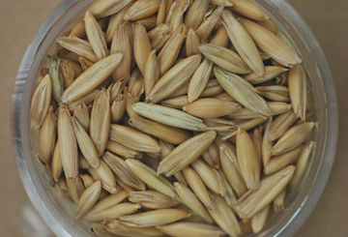
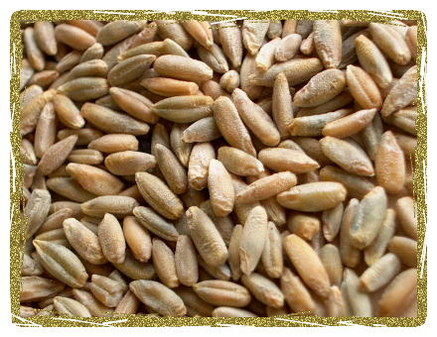
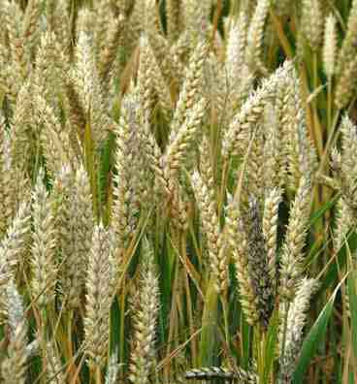
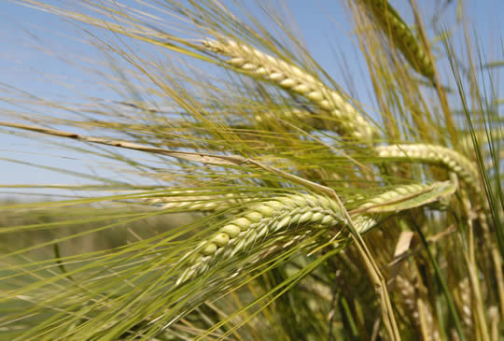
Climate and Crops
Europe
Dry Cereals: Wheat, Barley ,Oats or Rye

Slide 6
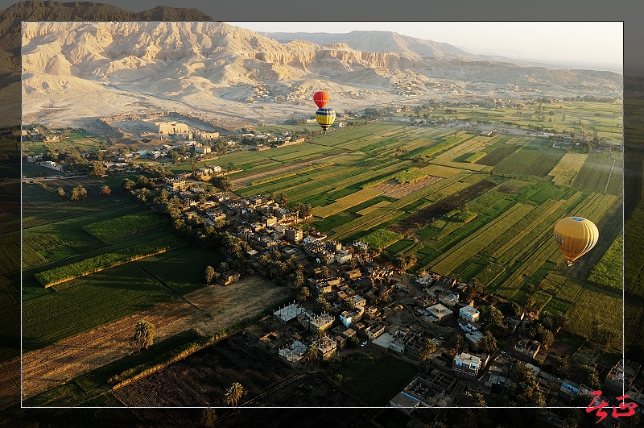
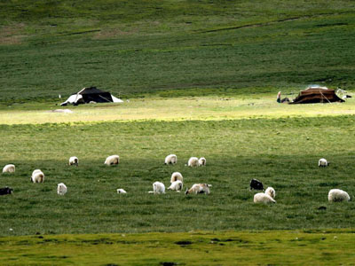
Central Asia and the Middle East

Slide 7
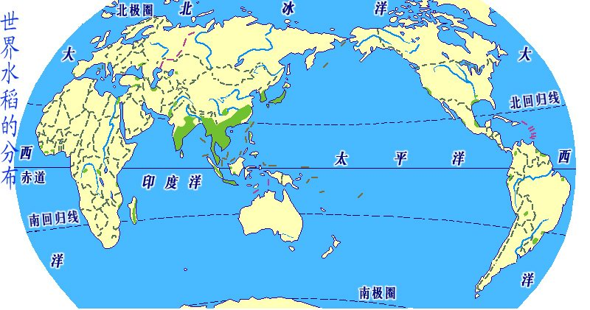
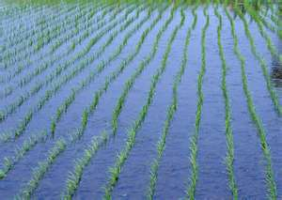
India, China, Korea, Japan, and Southeast Asia

Slide 8
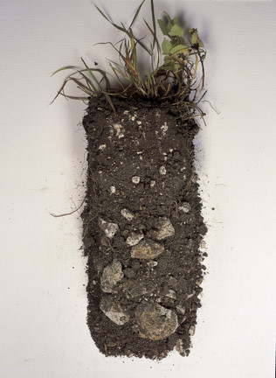
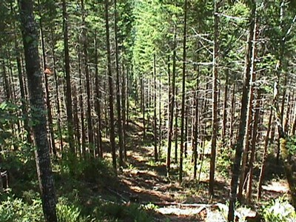
Soil of Europe
Chalky
Hardwood Forests

Slide 9
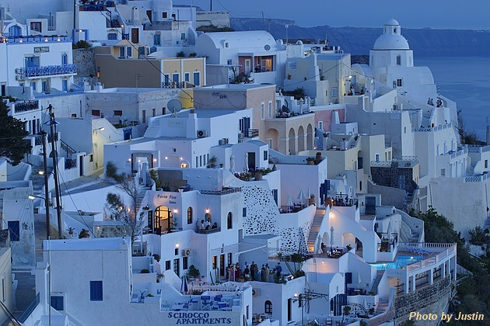
Mediterranean climate
Mediterranean climate
Rains in winter

Slide 10
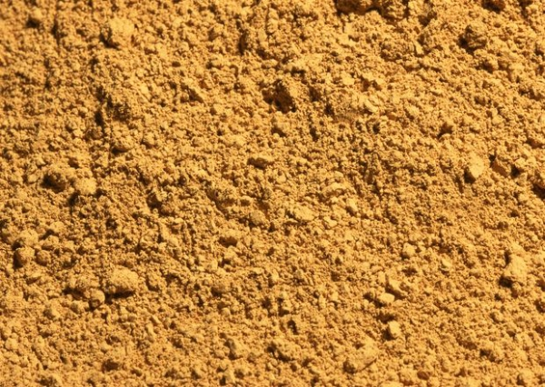
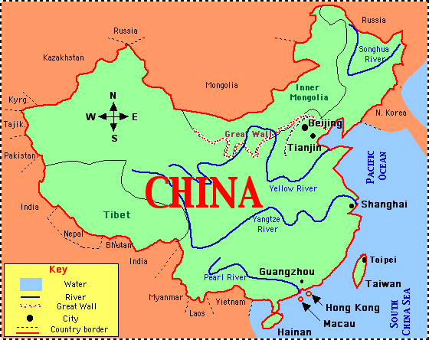
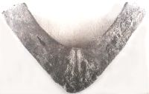
loess soil
犁鏵

Slide 11
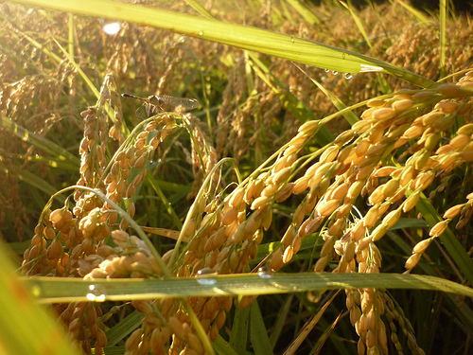
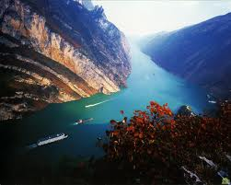
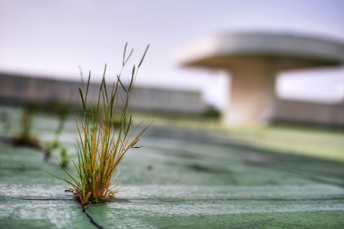
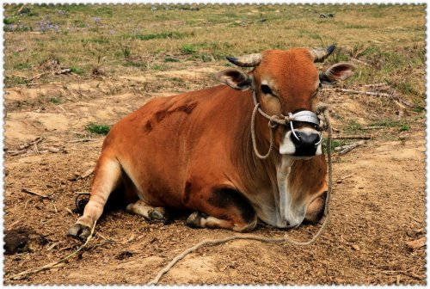
Advantages

Slide 12
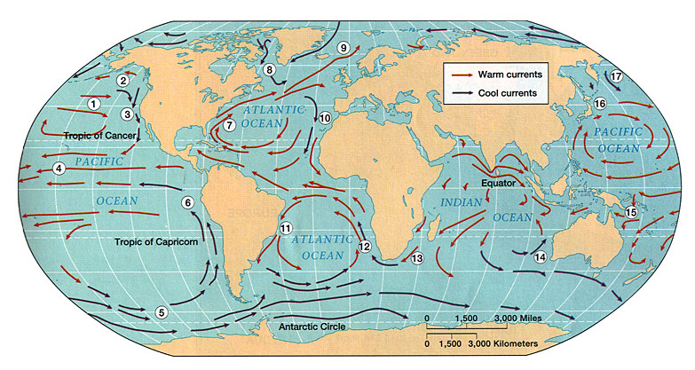
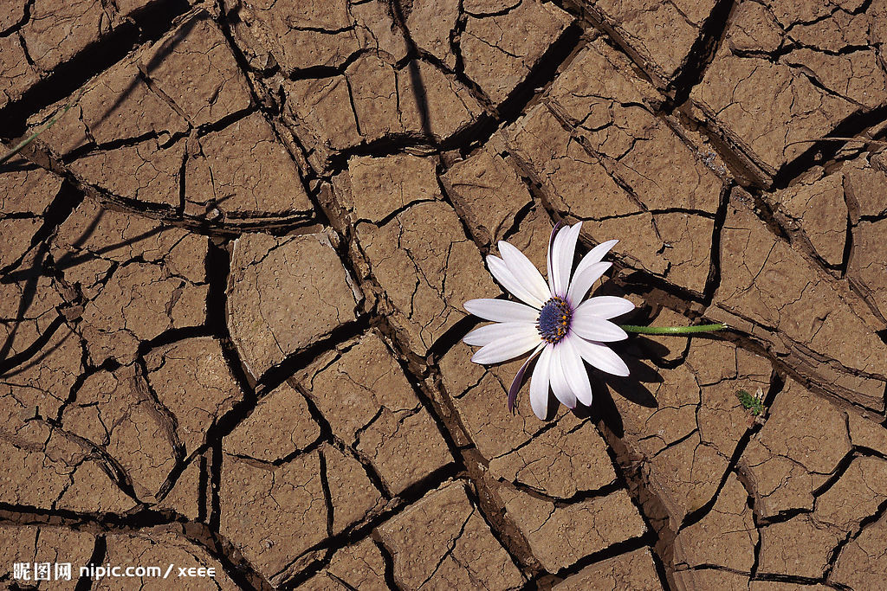
Disadvantages

Slide 13
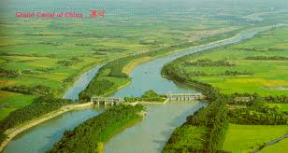
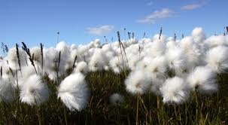
What Did We Have??
Technologies &
Marketable Products

Slide 14
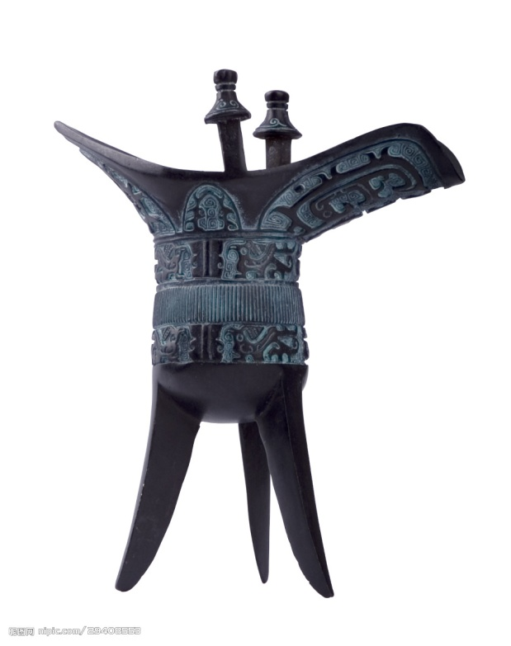
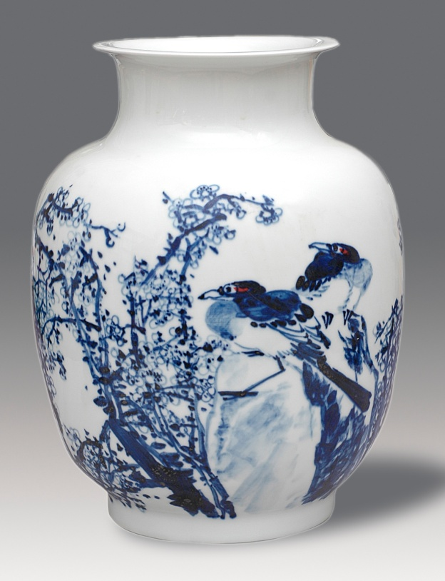
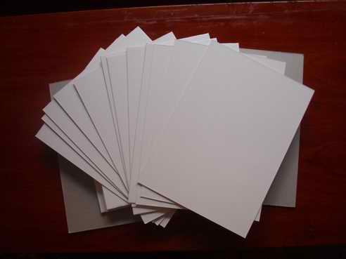
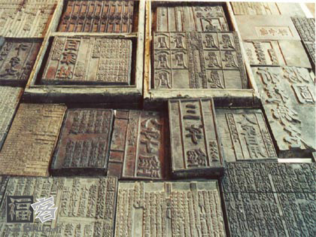
Material Engineering

Slide 15
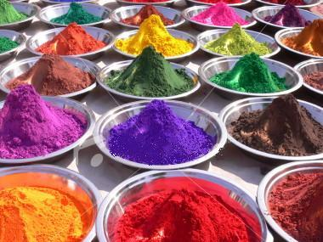
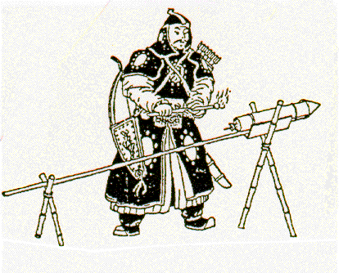
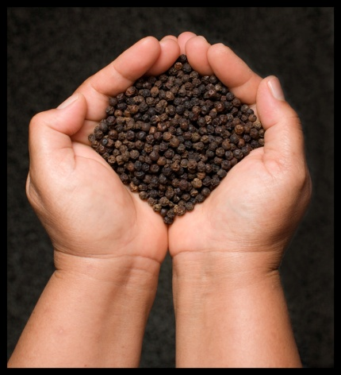
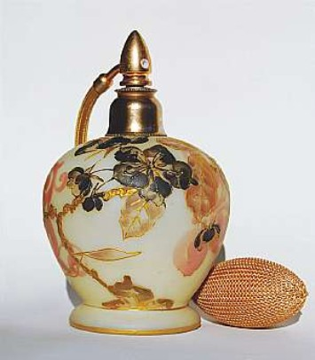
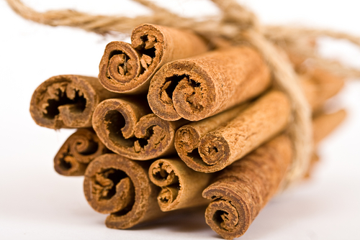
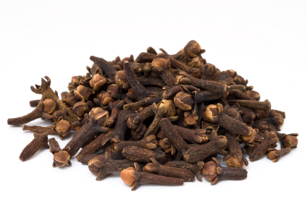
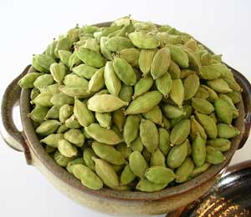
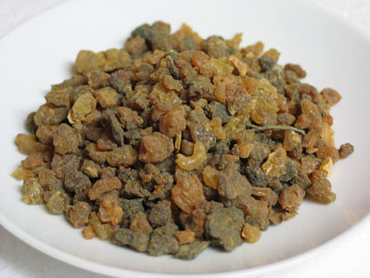
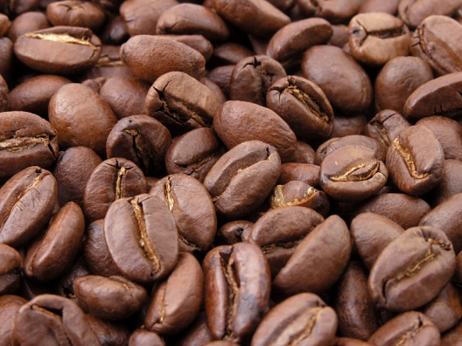
Marketable Products

Slide 16
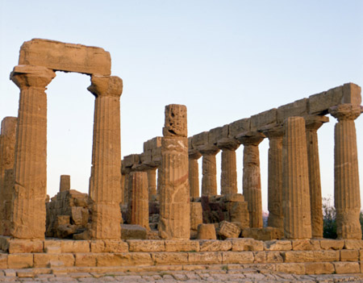
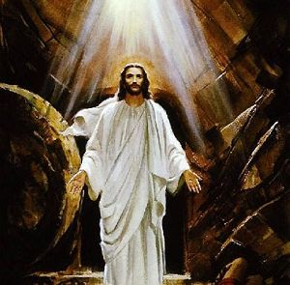
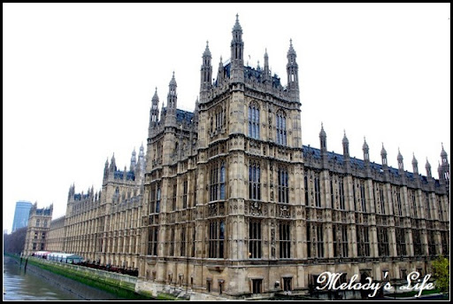
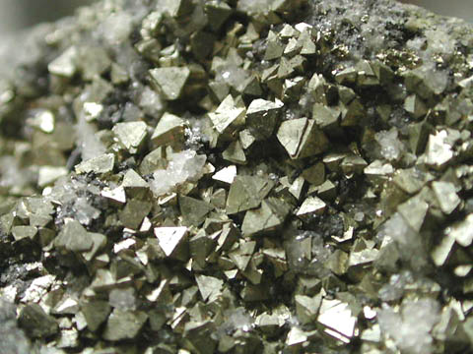
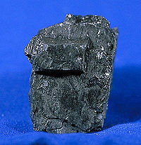
Why Europe?

Slide 17
The Early Seafaring in Europe
European seafarers had been relatively limited in their reach.
Most Europeans believed there was no sea route to the east.
Neither European rulers nor merchants were able to project any substantial presence outside of Europe itself.

Slide 18
The Early Seafaring in Asia
Western Europe was thus locked in, surrounded by the open ocean to the west and the powerful Ottoman Empire to the east.
Yet the civilizations of the Middle East and Asia were not so limited.

Slide 19
Columbus’ Discovery of the Americas
Both sought a direct route to the riches of the East to participate in the thriving trade beyond the Ottoman border.
Columbus’s discovery of the Americans got Europeans into the trading circuits of Asia.

Slide 20
Why Did the Europeans go through all that trouble ?
The answer is that these regions were richer, in almost every way.

